Slide 1
Lecture 5-1 Custom IP, XDC, Linker, Lab #4
IP Creation and Repository
IP Creation
IP Editing
IP Repository Location in Project Settings
Lab #4-1 AXI4-Lite Slave Custom IP:
led_ip\ip_repo\led_ip_1.0\hdl: led_ip_v1_0.v, led_ip_v1_0_S_AXI
led_ip\ip_repo\led_ip_1.0\drivers\led_ip_v1_0\src
Lab #4-2 Explained
XDC – Xilinx Design Constraints
Block RAM Generator IP for Zynq-7010
Standard ARM Programming Model
Linker Script and Address Management
Clock Configurations from ps7_init.html file
Board Support Package for led_ip

Slide 2
Assignment
Lab #4 Part 1: ZYNQ Lab 3 Use Vivado to Build Embedded Systems, pages ZYNQ3-1 to ZYNQ3-16.
Lab #4 Part 2: ZYNQ Lab 4 Adding IP Cores in PL, pages ZYNQ2-1 to ZYNQ2-16. Demonstrate this part to get credit for this lab.
References

Slide 3
IP Cores and Custom IP Blocks
Intellectual Property (IP) refers to preconfigured logic functions that can be used in your design.
An IP contains its hardware design and software driver.
A core IP is provided by Xilinx and a custom IP is created by user.
All IP available in the Vivado IP Catalog can be used to create IP Integrator designs
Any IP Integrator block design can be quickly packaged as a single complex IP
IP repository

Slide 4
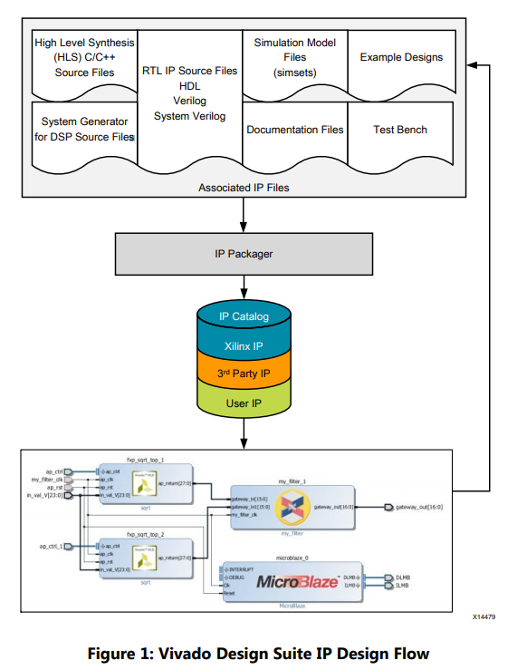
IP Files, IP Packager, IP Repositories
IP files
Sources
Simulation files
Examples
Test bench
Documentation
Driver
IP Packager
Create and edit IP
IP Repository is a storage location for all IP files

Slide 5
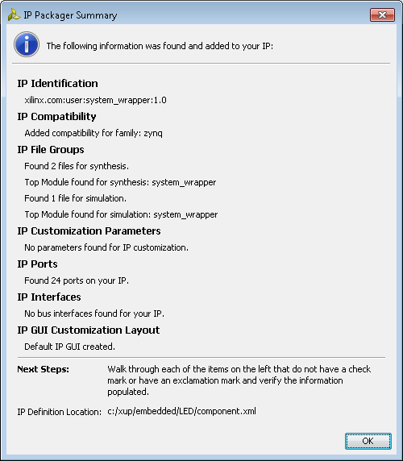
IP Packager
Automatically analyse project/files to determine parameters
Initial Summary
Identifies
Files
Source HDL, Testbenches, Documentation,
Parameters
Configurable
Ports
Interfaces
Compatibility
Creates GUI Layout for IPI

Slide 6
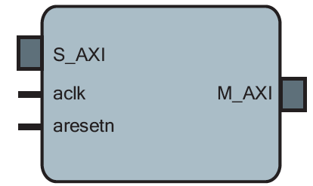
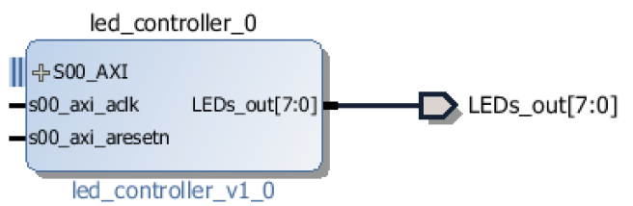
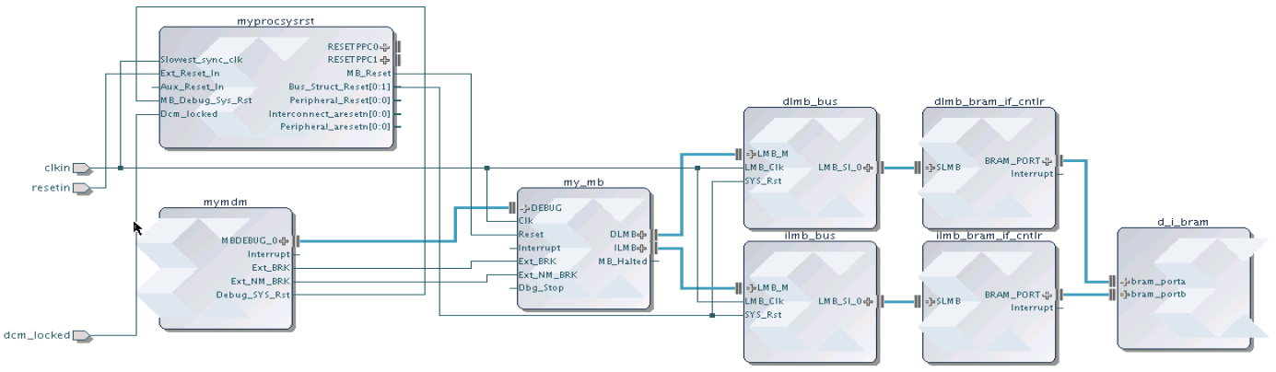
Example IP Core and Custom IP
AXI Interface IP core from library
Source
Simulation models
Documentation
Test bench
Example designs
driver
Custom IP design with AXI interface
Standardized IP-XACT representation
Vivado IP Integrator
IP Catalog
Source (C, RTL, IP, etc)
IP Packager
Simulation Models
Xilinx IP
Documentation
Example Designs
3rd Party IP
Test Bench
User IP

Slide 7
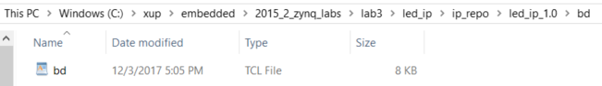
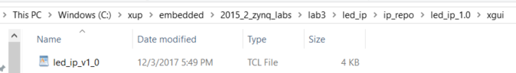
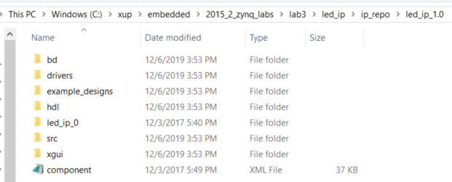
Files Created for an IP Component
bd - Block Diagram tcl file
drivers
SDK and software files (c code)
hdl - Verilog/VHDL code (should be inside project directory)
src – source code for the IP component
xgui - GUI tcl file to represent the layout symbol of IP
component.xml IP XACT description

Slide 8
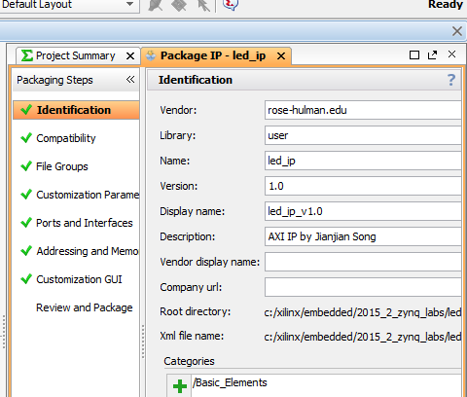
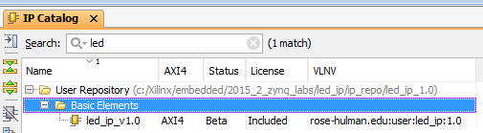
Edit IP in Block Design
To edit an IP in a block design
Right click on an IP instance on Block Design to choose Edit IP in Packager to open a new Vivado project
Template files have been generated and are added to the project
IP can now be edited
Modify existing template files, add user source files
IP Packager will be open
Last step is to Package IP

Slide 9
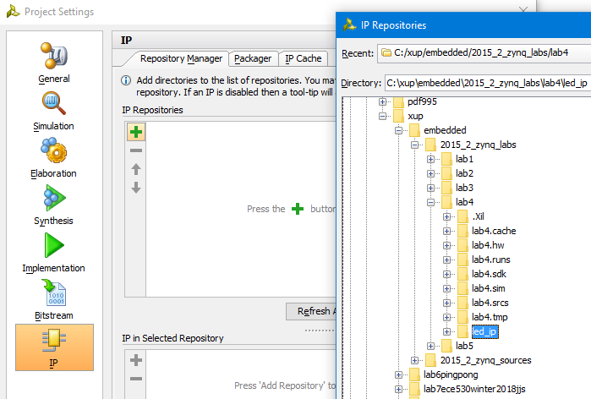
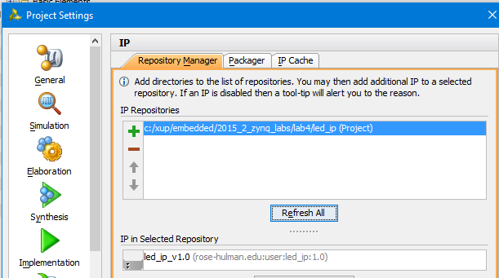
Add an IP from Repository to Your Project
To add an IP to your project
Start Project Settings
Choose IP icon
IP directory will not change
I prefer to copy an IP to its user’s folder so that the IP will not be misplaced.

Slide 10
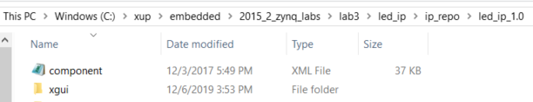

IP-XACT
Industry Standard (IEEE) XML format to describe IP using meta-data
Ports
Interfaces
Configurable Parameters
Files, documentation
IP-XACT only describes high level information about IP, not low level description, so does not replace HDL or Software.
Enables automatic connection, configuration and integration
Enables integration of 3rd Party IP
(And Export of your own IP)

Slide 11
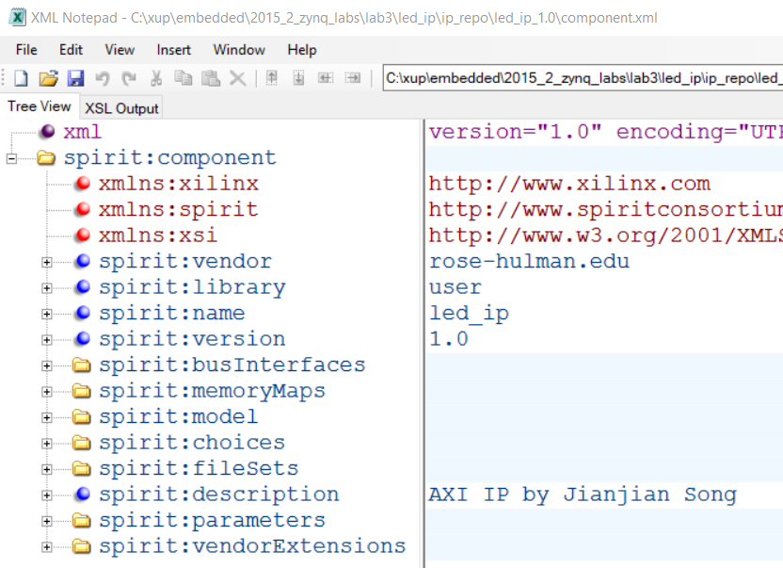
Component.xml for led_ip_1.0

Slide 12
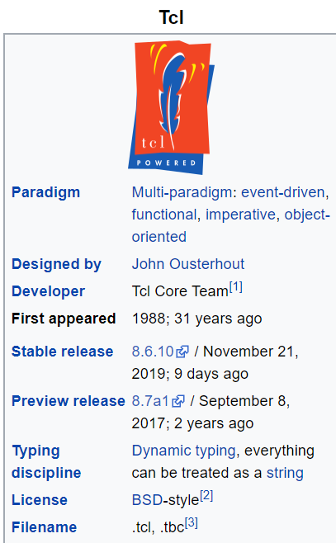
*.tcl files
TCL, Tool Command Language , is a file extension for a script written in TCL.
Tool Command Language (TCL) is a dynamic open source language used for building web and desktop applications. Whether on Windows, Mac OS X, or Linux operating systems, TCL files can be opened and edited by WISH and TCLSH.
https://en.wikipedia.org/wiki/Tcl
Notes:
Tcl (pronounced "tickle" or tee cee ell /ˈtiː siː ɛl/^{[6]}) is a high-level, general-purpose, interpreted, dynamic programming language. It was designed with the goal of being very simple but powerful.^{[7]} Tcl casts everything into the mold of a command, even programming constructs like variable assignment and procedure definition.^{[8]} Tcl supports multiple programming paradigms, including object-oriented, imperative and functional programming or procedural styles.
It is commonly used embedded into C applications,^{[9]} for rapid prototyping, scripted applications, GUIs, and testing.^{[10]} Tcl interpreters are available for many operating systems, allowing Tcl code to run on a wide variety of systems. Because Tcl is a very compact language, it is used on embedded systems platforms, both in its full form and in several other small-footprint versions.^{[11]}

Slide 13
Lab #4 Part 1: Adding Custom IP to the System, XUP ZYNQ 3
Lab #4 Part 1: ZYNQ Lab 3 Use Vivado to Build Embedded Systems, pages ZYNQ3-1 to ZYNQ3-16.
Lab #4 Part 2: ZYNQ Lab 4 Adding IP Cores in PL, pages ZYNQ2-1 to ZYNQ2-16. Demonstrate this part to get credit for this lab.
Create and Package IP
Generates HDL template for
Slave/Master
AXI Lite/Full/Stream
Optionally Generates
Software Driver
Only for AXI Lite and Full slave interface
Test Software Application

Slide 14
Lab #4 Part 1: Adding Custom IP to the System, XUP ZYNQ 3
The User IP in led_ip_v1_0.v contains a register to store LED data
The IP is clocked and reset by PS
LEDs themselves do not store data
led_ip_v1_0_S_AXI.v
AXI Interconnect
AXI4-Lite IP (Slave)
led_ip_v1_0.v
User IP
Write Addr
AXI Transaction logic
(Ready, Valid, Response)
Write Data
Write Response
8-bit LED Register
8-bit output
Read Addr
Registers
Read Data
lab3_user_logic.v

Slide 15
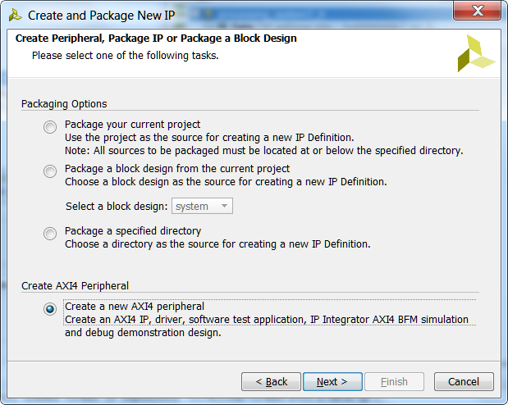
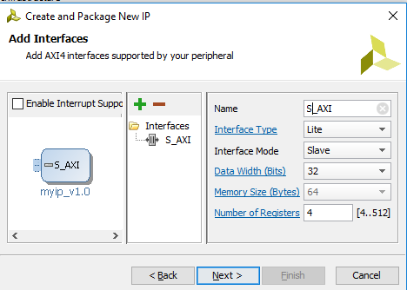
Create an AXI Lite IP from the AXI Lite Template
HDL implementation of AXI Interface is available
32 bit data width
User specifies required number of registers (minimum 4)
Read/write to/from Registers implemented
User logic can be easily connected
User logic can be a hierarchical design

Slide 16
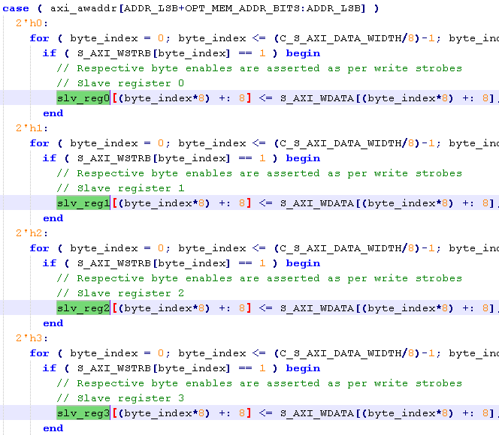
A Generated Template for AXI LED

Slide 17
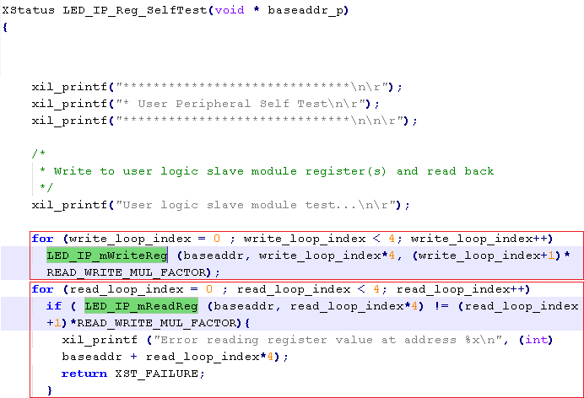
Subroutines in its Driver Library

Slide 18
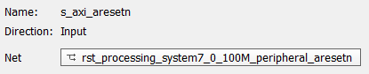
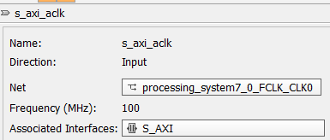
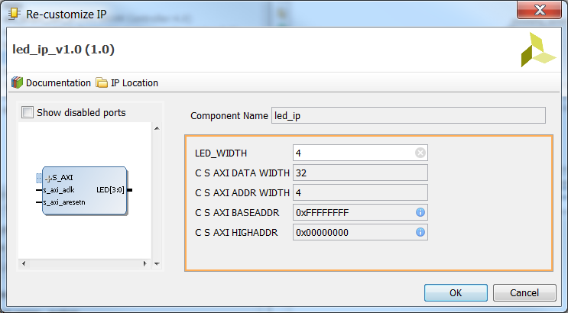
AXI4-Lite Slave Custom IP: led_ip_v1_0.v
S_AXI bus- standard template
axi_aclk
System clock from PS
Axi_aresetn
System reset from PS
LED[3:0]
custom port

Slide 19
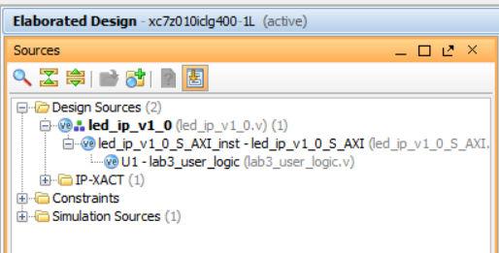
Three Levels: led_ip_v1_0.v, led_ip_v1_0_S_AXI, lab3_user_logic
Top: led_ip_v1_0.v – the wrapper
AXI: led_ip_v1_0_S_AXI – Verilog module
Slave axi4 standard template
Custom: lab3_user_logic – user IP circuit in led_ip_v1_0_S_AXI.v
8-bit LED register to store data
Under IP Editor for led_ip_v1_0

Slide 20
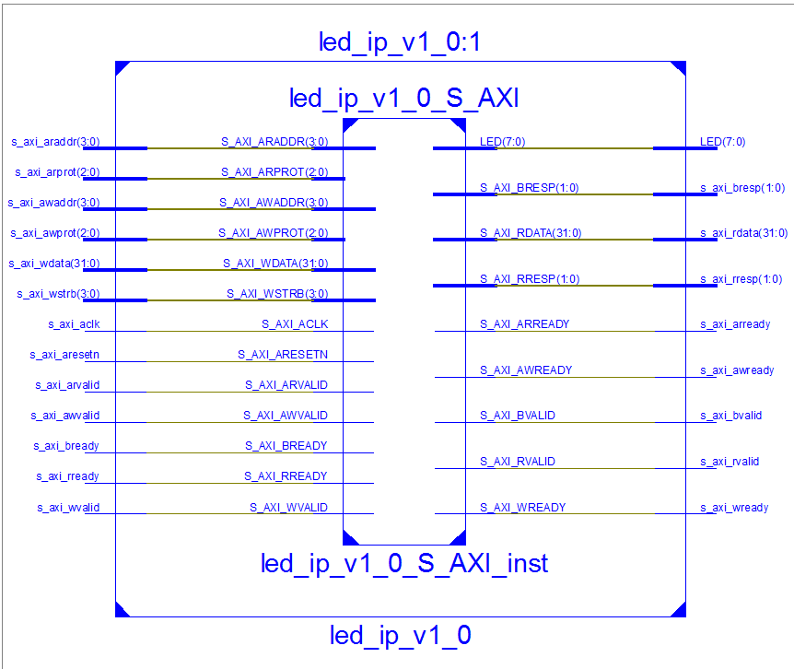
AXI4-Lite Slave IP: led_ip_v1_0.v, led_ip_v1_0_S_AXI, lab3_user_logic
This view is generated by Xilinx ISE tools to see three levels of modules
LED wires need to be declared on all three levels.
lab3_user_logic

Slide 21
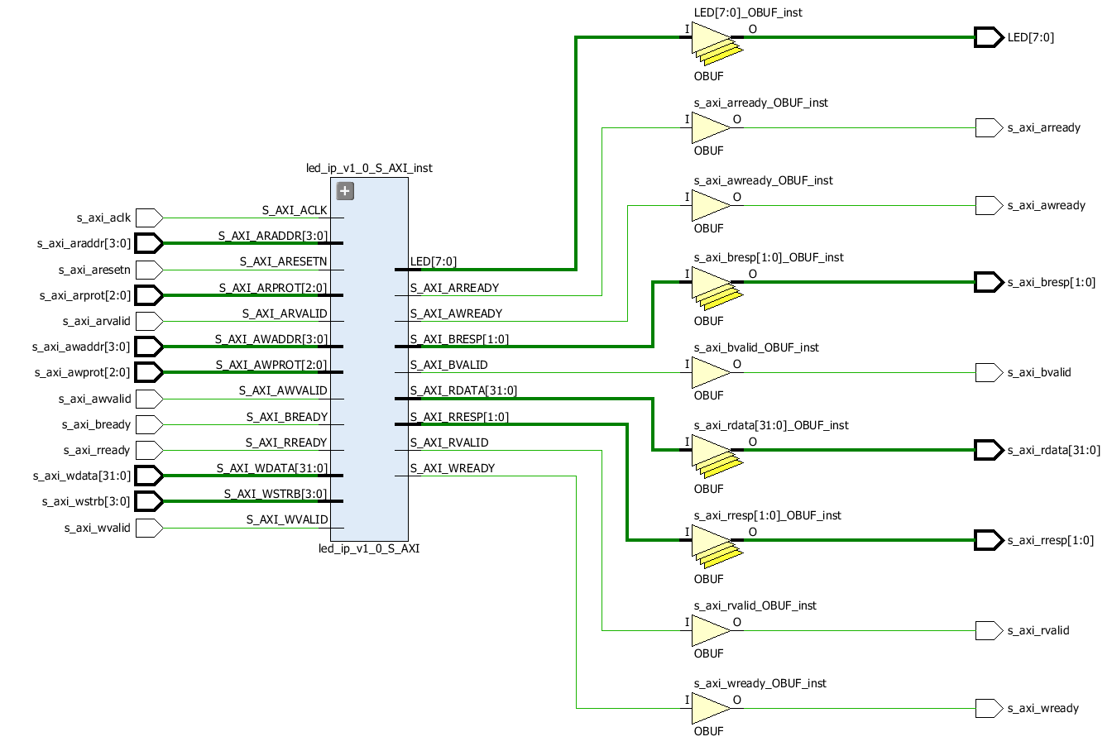
AXI4-Lite Slave IP: led_ip_v1_0.v, led_ip_v1_0_S_AXI, lab3_user_logic
This view is generated by Elaborated Design under RTL Analysis
lab3_user_logic
lab3_user_logic

Slide 22
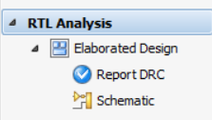
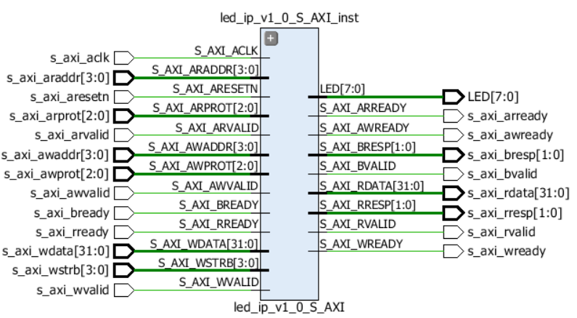
AXI4-Lite Slave IP: module led_ip_v1_0.v
With IP Editor: Run RTL Analysis->Schematic to obtain schematic
4-bit addresses for read s_axi_araddr[3:0] and write s_axi_awaddr[3:0]
8-bit LED LED[7:0], which is a changeable parameter
32-bit read and write data busses

Slide 23
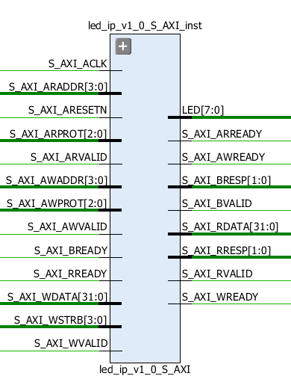
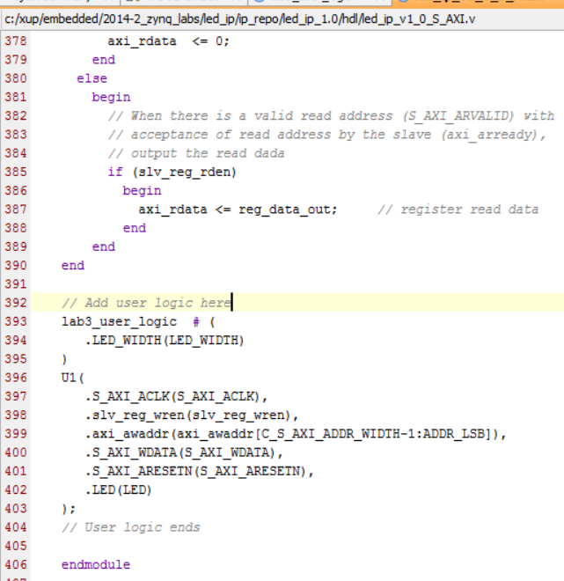
AXI4-Lite Slave IP: , led_ip_v1_0_S_AXI
This is a standard axi4-lite slave module template
lab3_user_logic module is inserted into this template to create a custom IP

Slide 24
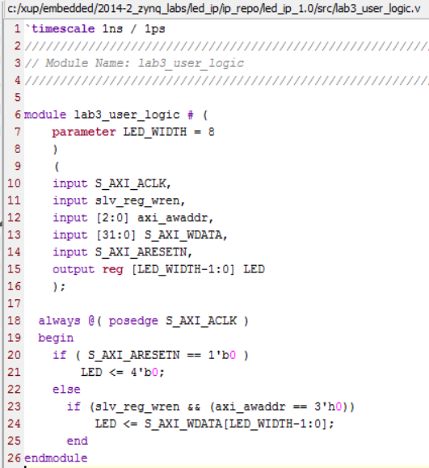
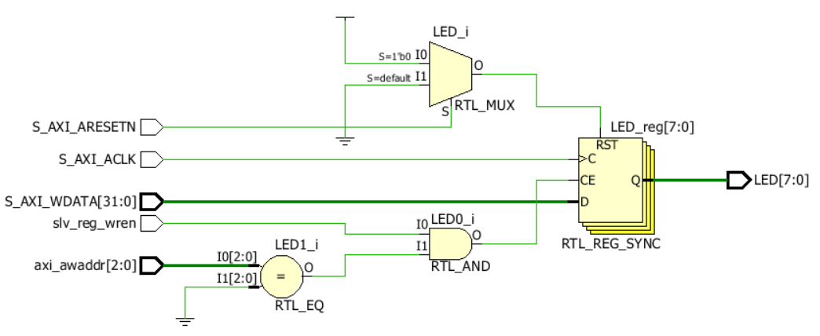
AXI4-Lite Slave IP: module lab3_user_logic
Create an 8 bit register to store 8-bit data of 32-bit Write Data from axi slave interface
This 8-bit data can be displayed on LEDs
Reset by S_AXI_ARESETN
Clocked by S_AXI_ACLK
Enabled by slv_reg_wren and axi_asaddr==3’h0, 12 bit address
Take 8 bits of 32 bit data on S_AXI_WDATA
Notice the magic numbers!

Slide 25
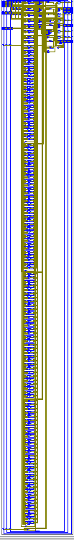
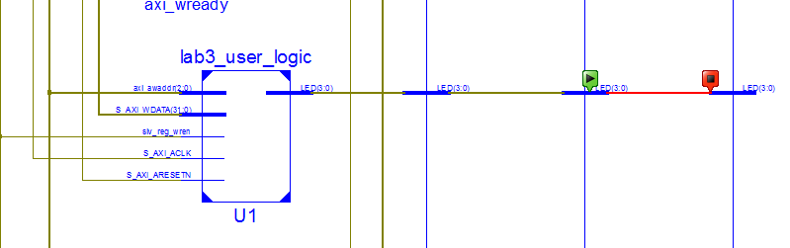
AXI4-Lite Slave IP: lab3_user_logic module, 3 level deep
lab3_user_logic.v under led_ip_v1_0_S_AXI.v
lab3_user_logic

Slide 26
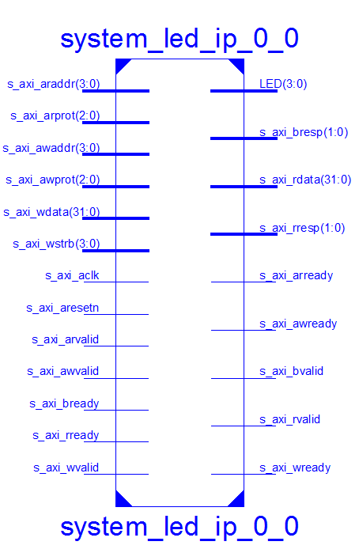
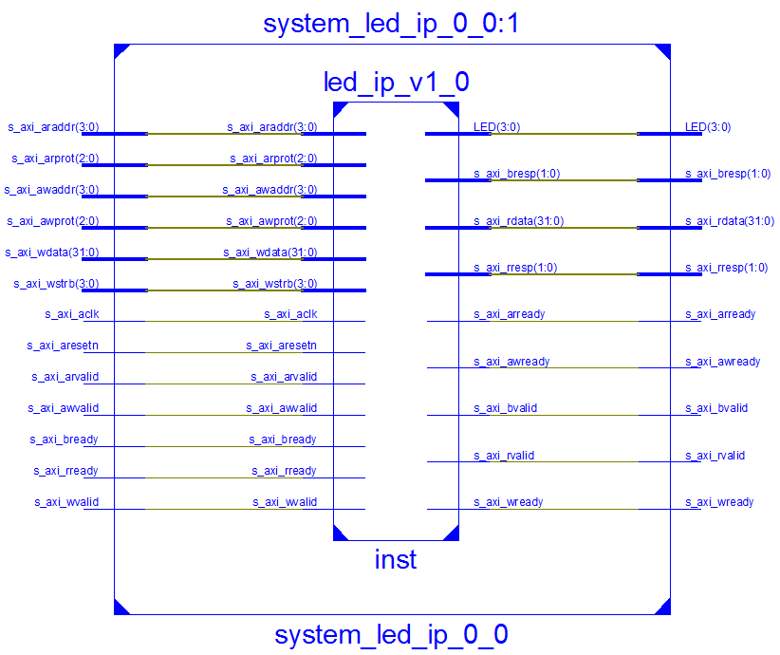
One Instance of led_ip_v1_0.v with four LEDs
System_led_ip_0_0.v == led_ip_v1_0.v, notice LED[3:0]
These Schematics are generated with Xilinx ISE

Slide 27
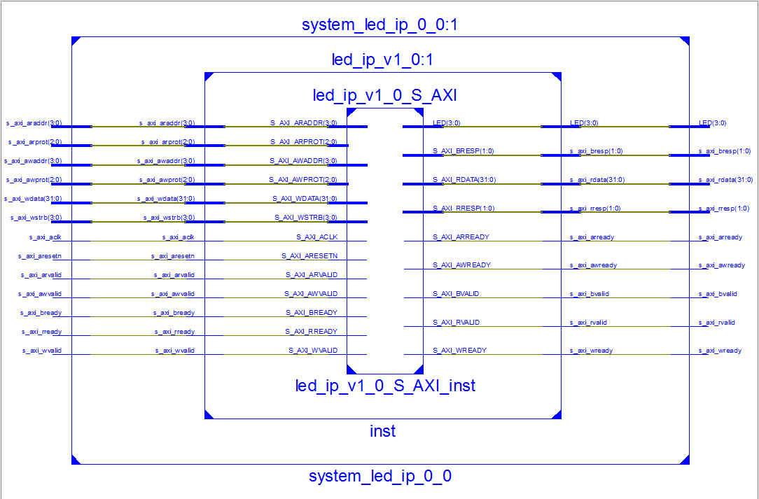
One Instance of led_ip_v1_0.v with four LEDs
System_led_ip_0_0.v == led_ip_v1_0.v, notice LED[3:0]
lab3_user_logic.v is in led_ip_v1_0_S_AXI_inst

Slide 28
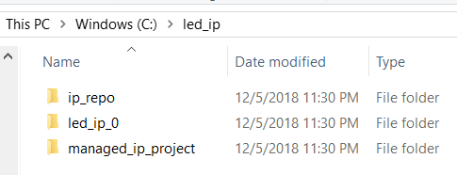
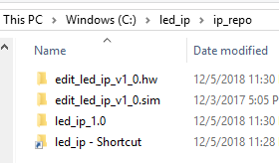
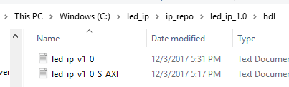
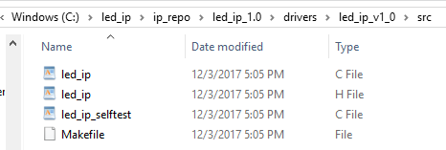
led_ip_v1_0 IP folder: Hardware and Driver
Three folders
ip_repo (repository folder)
led_ip_0
Managed_ip_project
hdl folder in led_ip_0 folder
led_ip_v1_0.v
Led_ip_v1_0_s_AXI.v
driver folder in led_ip_0 folder
led_ip.c
led_ip.h
led_ip_selftest.c
Makefile

Slide 29
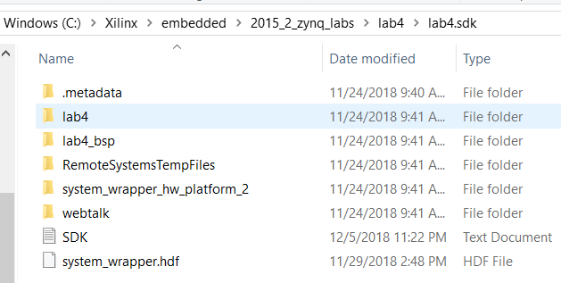
led_ip_v1_0 Driver files
Driver files are exported to SDK as part of board support package *.bsp folder
led_ip.c - #include "led_ip.h"
led_ip.h
#define LED_IP_mWriteReg(BaseAddress, RegOffset, Data) \ Xil_Out32((BaseAddress) + (RegOffset), (u32)(Data))
#define LED_IP_mReadReg(BaseAddress, RegOffset) \ Xil_In32((BaseAddress) + (RegOffset))
XStatus LED_IP_Reg_SelfTest(void * baseaddr_p);
led_ip_selftest.c
Makefile

Slide 30
Lab #4 Part 2: Writing Basic Software Application and Block RAM
Read and display slide switches and buttons on terminal 1
Send slide switch values to LEDs
Change memory allocation by linker Script
Lab #4 Part 1: ZYNQ Lab 3 Use Vivado to Build Embedded Systems, pages ZYNQ3-1 to ZYNQ3-16.
Lab #4 Part 2: ZYNQ Lab 4 Adding IP Cores in PL, pages ZYNQ2-1 to ZYNQ2-16. Demonstrate this part to get credit for this lab.
ARM
Cortex-A9
PL
Memory
DDR3
Memory
Controller
RS232
UART
AXI
Interconnect
Block
AXI4
AXI-BRAM Controller
BRAM
AXI4-Lite
LED_IP
LED
M_AXI_GP0
AXI4-Lite
GPIO
Push-Buttons
PS
AXI4-Lite
GPIO
DIP Switches

Slide 31
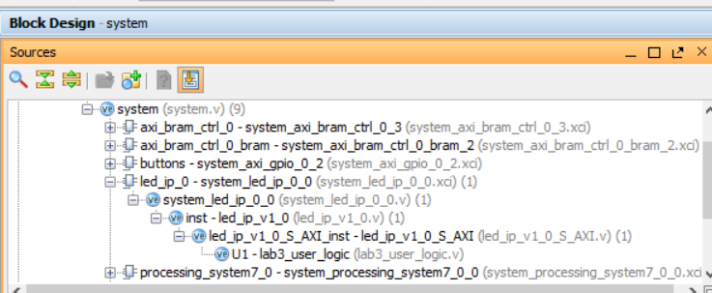
Lab #4 Part 2: Block Design: Use One Instance of led_ip
Notice led_ip_v1_0.v has been wrapped by one more higher level system wrapper: system_led_ip_0_0.v
System_led_ip_0_0.xci
The XCI file is an IP-XACT component instance XML file that records the values of project options, customization parameters, and port parameters used to create the IP. From page 14, ug895-vivado-system-level-design-entry.pdf

Slide 32
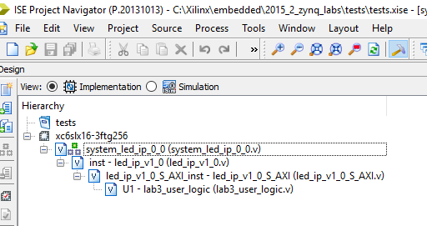
Three Levels of led_ip_v1_0.v IP with four LEDs
system_led_ip_0_0.v from
C:\Xilinx\embedded\2015_2_zynq_labs\lab4\lab4.srcs\sources_1\bd\system\ip\system_led_ip_0_0\synth
led_ip_v1_0.v and led_ip_v1_0_S_AXI.v from
C:\Xilinx\embedded\2015_2_zynq_labs\led_ip\ip_repo\led_ip_1.0\hdl
lab3_user_logic.v from
C:\Xilinx\embedded\2015_2_zynq_labs\led_ip\ip_repo\led_ip_1.0\src
Xilinx ISE

Slide 33
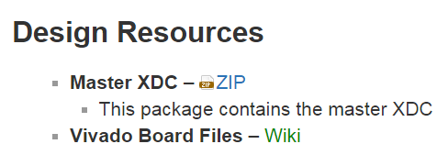
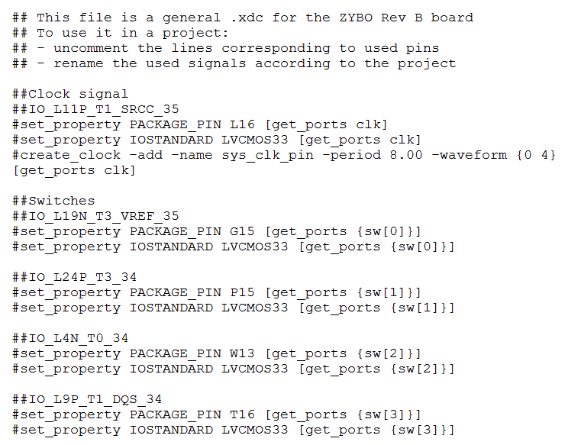
Xilinx Design Constraints (XDC) File for Zybo: Master XDC zip
A zipped file called ZYBO_Master.xdc is available from https://github.com/Digilent/ZYBO/tree/master/Resources/XDC.
Here is the header of ZYBO_Master.xdc

Slide 34
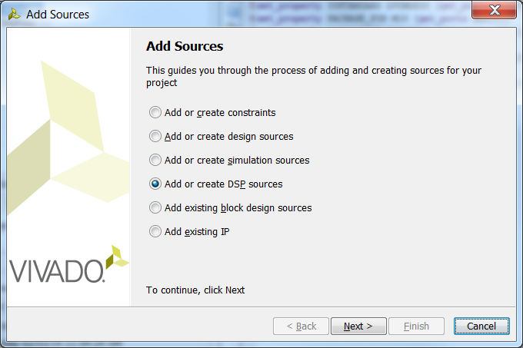
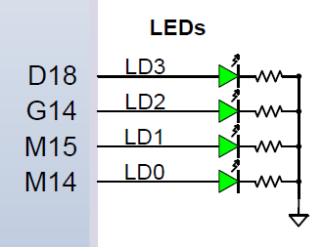
Add constraints file lab3_zybo.xdc
Xilinx Design Constraints (XDC) File
Specify pin positions where LEDs are located
PACKAGE_PIN is a property followed by a physical pin number
get_ports applies the property to a logical port
############################
# On-board LED #
############################
set_property PACKAGE_PIN M14 [get_ports LED[0]]
set_property IOSTANDARD LVCMOS33 [get_ports LED[0]]
set_property PACKAGE_PIN M15 [get_ports LED[1]]
set_property IOSTANDARD LVCMOS33 [get_ports LED[1]]
set_property PACKAGE_PIN G14 [get_ports LED[2]]
set_property IOSTANDARD LVCMOS33 [get_ports LED[2]]
set_property PACKAGE_PIN D18 [get_ports LED[3]]
set_property IOSTANDARD LVCMOS33 [get_ports LED[3]]

Slide 35
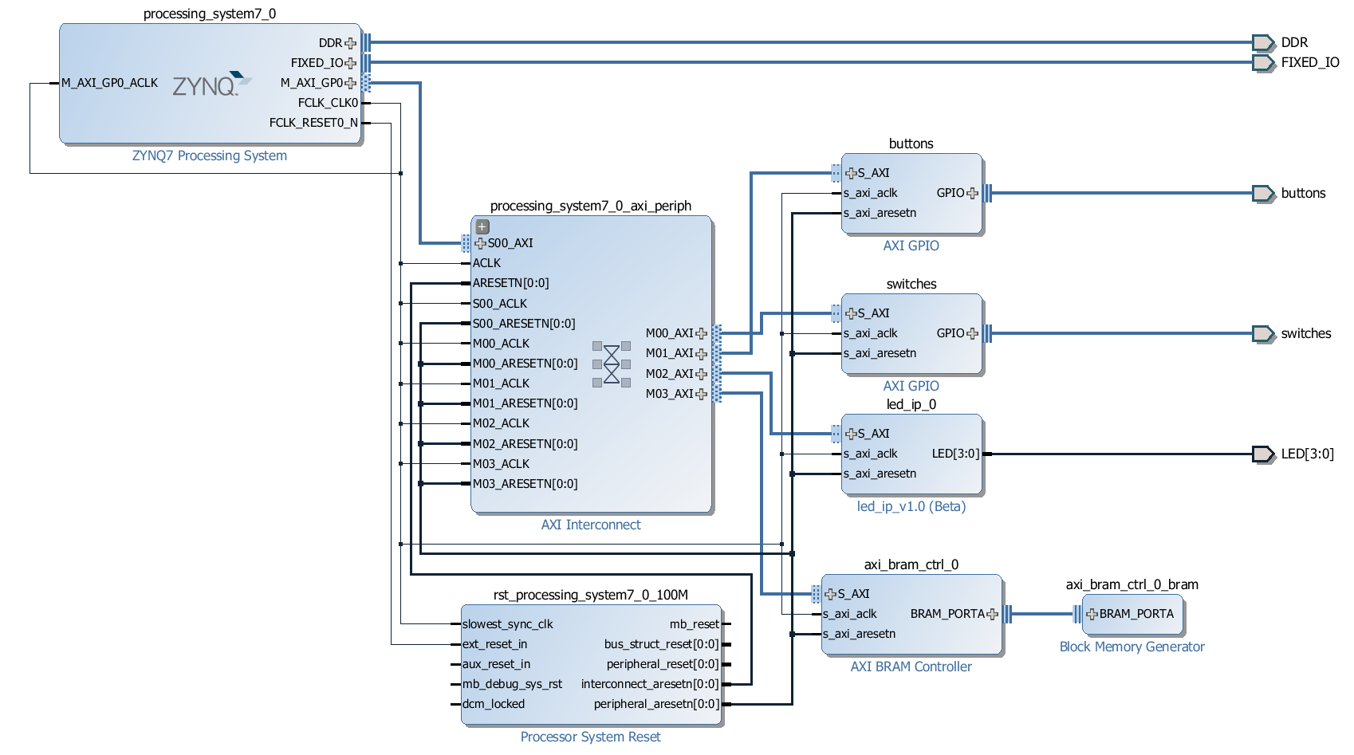
Lab #4 Part 2: top Level Circuit
buttons and switches are standard S_AXI4 lite interfaces
led_ip_0 and axi_bram_ctrl_0 are custom IP S_AXI4 interfaces

Slide 36
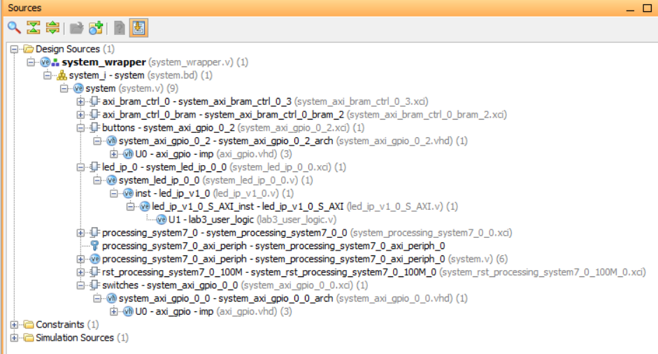
Lab #4 Part 2: top Level Circuit
buttons and switches are standard S_AXI4 lite interfaces
led_ip_0 and axi_bram_ctrl_0 are custom IP S_AXI4 interfaces

Slide 37
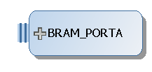



Block RAM Generator IP for Zynq-7010
AXI Block RAM controller IP, AXI4 Slave
Block RAM IP, Single Port RAM
36Kb block RAM x 60 blocks
True dual-port
Up to 72 bits wide
Configurable as dual 18 Kb block RAMs

Slide 38


Synchronous Dual-Port and Single-Port RAMs (UG473 7 Series FPGAs Memory Resources)
Two independent access ports
No arbitration between the ports
Write conflict will not cause physical damage but may cause data loss
Zynq-2010 BRAM: 36Kbx60=2.16Mb
In FPGA area

Slide 39

Standard ARM Programming Model
Processing system and programmable logic look the same
AMBA® and AXI interfaces
Memory-mapped I/O
Register access
Consistency for PS and PL = ease of use
Memory map usage: total of 4 GB
1 GB: DDR RAM
2 GB: dedicated to PL peripherals
1 GB: PS peripherals, on-chip memory (OCM), external flash

Slide 40


Programmer’s View of Programmable Logic
Programmable logic (PL) memory map
2 GB total space
1 GB for each AXI master: GP0, and GP1
Accessible from any processing system (PS) master
Either Cortex-A9 CPU
PS DMA engine
PS peripheral DMA engine
Ethernet
USB
SD/SDIO
Custom Peripheral
Code Snippet

Slide 41
Address Management
Embedded processor design requires managing the following:
Address map for the peripherals
Location of the application code in the memory space
Block RAM
SRAM
External memory (Flash, DDR3)
Memory requirements are based on the following:
The amount of memory required for storing instructions
The amount of memory required for storing data associated with the program
Executables and static data must be allocated in On-Chip RAM or DRAM
Heap and stack can be allocated in Block RAM

Slide 42
Linker and Locator Flows
.text contains executable code
.data segment contains initialized data
.bss segment contain uninitialized data
foo1.o
Executable Image
Merged Output Sections
.text1
0x0000
.text Code
.data1
0x0FF0
.text
Locate
.bss1
.data Initialized data
Link
.data
foo2.o
.bss uninitialized data
.bss
.text2
0xF000
Heap
.data2
.bss2
Stack
0xFFFF

Slide 43

Linker Properties and Linker Script
The Root panel displays properties for the selected configuration
Shown are the linker options for the Debug configuration
Default settings are fine for simple applications
Linker script controls the linking process
Map the code and data to a specified memory space
Set the entry point to the executable
Reserve space for the stack
Required if the design contains a discontinuous memory space

Slide 44



SDK Project: Linker Script
Application Software Project
A code
Linker script file
Board Support Package *.bsp
Hardware Platform – system_wrapper
Linker Script

Slide 45



Linker Script Generator GUI and File lscript.ld
Launch from Xilinx Tools > Generate Linker Script, or from the C/C++ perspective, right-click on <project> > Generate Linker Script
Table-based GUI allows you to define the memory space for code and data sections
The tool will create a new linker script (the old script is backed up)
C:\Xilinx\embedded\2015_2_zynq_labs\lab4\lab4.sdk\lab4\src\lscript.ld

Slide 46

Linker Script Generator GUI
Notice the base address and size of each memory block
Both RAM blocks and DDR RAM can be used to store executable and static data
DDR2 memory size is 511MB
Block RAM size is 8KB and operates
RAM_0 is 192KB and RAM_1 is about 64 KB
File location: C:\Xilinx\embedded\2015_2_zynq_labs\lab4\lab4.sdk\lab4\src\lscript.ld

Slide 47

Board Support Package Macros for led_ip in led_ip.h
#ifndef LED_IP_H
#define LED_IP_H
/****************** Include Files ********************/
#include "xil_types.h"
#include "xstatus.h"
#define LED_IP_S_AXI_SLV_REG0_OFFSET 0
#define LED_IP_S_AXI_SLV_REG1_OFFSET 4
#define LED_IP_S_AXI_SLV_REG2_OFFSET 8
#define LED_IP_S_AXI_SLV_REG3_OFFSET 12
#define LED_IP_mWriteReg(BaseAddress, RegOffset, Data) \
Xil_Out32((BaseAddress) + (RegOffset), (u32)(Data))
#define LED_IP_mReadReg(BaseAddress, RegOffset) \
Xil_In32((BaseAddress) + (RegOffset))
XStatus LED_IP_Reg_SelfTest(void * baseaddr_p);

Slide 48
Xil_Out32(), Xil_in32() in standard_v4_2/src/xil_io.c
/* Performs an input operation for a 32-bit memory location by reading from the
* specified address and returning the Value read from that address.
** @paramAddr contains the address to perform the input operation at.
* @returnThe Value read from the specified input address.
* @noteNone. */
u32 Xil_In32(u32 Addr)
{
return *(volatile u32 *) Addr;
}
Read (return) content at address Addr
/* Performs an output operation for a 32-bit memory location by writing the
* specified Value to the specified address.
* @paramOutAddress contains the address to perform the output operation at.
* @paramValue contains the Value to be output at the specified address.
* @returnNone.
* @noteNone */
void Xil_Out32(u32 OutAddress, u32 Value)
{
*(volatile u32 *) OutAddress = Value;
}
Level 0 Driver
Write (store) Value to content at address Addr

Slide 49
LED device defined in xparameters.h
/* Definitions for driver LED_IP */
#define XPAR_LED_IP_NUM_INSTANCES 1
/* Definitions for peripheral LED_IP_0 */
#define XPAR_LED_IP_0_DEVICE_ID 0
#define XPAR_LED_IP_0_S_AXI_BASEADDR 0x43C00000
#define XPAR_LED_IP_0_S_AXI_HIGHADDR 0x43C0FFFF

Slide 50

Lab #4 Part 2: main() to display slide switch values on LEDs
#include "xparameters.h"
#include "xgpio.h"
#include "led_ip.h"
int main (void)
{
XGpio dip, push;
int i, psb_check, dip_check;
xil_printf("-- Start of the Program --\r\n");
XGpio_Initialize(&dip, XPAR_SWITCHES_DEVICE_ID);
XGpio_SetDataDirection(&dip, 1, 0xffffffff);
XGpio_Initialize(&push, XPAR_BUTTONS_DEVICE_ID);
XGpio_SetDataDirection(&push, 1, 0xffffffff);
while (1) {
psb_check = XGpio_DiscreteRead(&push, 1);
xil_printf("Push Buttons Status %x\r\n", psb_check);
dip_check = XGpio_DiscreteRead(&dip, 1);
xil_printf("DIP Switch Status %x\r\n", dip_check);
LED_IP_mWriteReg(XPAR_LED_IP_S_AXI_BASEADDR,0,dip_check);
for (i=0; i<9999999; i++); }
}

Slide 51

Three Linker Memory Options: Internal RAM, Block RAM, DDR RAM
ps7_ram_0_S_AXI_BASEADDR, fastest, internal RAM in PS based at 0x00000000 or 0xFFFF0000
ps7_ddr_0_S_AXI_BASEADDR, faster, external DDR memory based at 0x00100000
axi_bram_ctrl_0, slow, very slow – internal block RAM in PL based at 0x40000000

Slide 52

Memory Clock Speeds: Internal, Block RAM, DDR
650MHz - ps7_ram_0_S_AXI_BASEADDR
525MHz - ps7_ddr_0_S_AXI_BASEADDR
100MHz - axi_bram_ctrl_0

Slide 53


Clock Configurations from ps7_init.html file on SDK
Click on ps7_init.html in bsp folder
Click CLK Configuration to see (1) crystal speed, (2) CPU speed, (3) UART speed, (4) four FPGA clock speed
Click DDR Configuration to see DDR clock speed

Slide 54

Memory Allocation
Heap and Stack in BRAM: axi__bram_ctrl_0_S_AXI_BASEADDR=0x4000000
Code and Data in DDR: ps7_ddr_0_S_AXI_BASEADDR=0x0010000

Slide 55

Object Dump: lab4.elf
C:\Xilinx\embedded\2016_2_zynq_labs\lab4\lab4.sdk\lab4\Debug
lab4.elf
Open a command shell
>under command shell: arm-Xilinx-eabi-objdump –h lab4.elf

Slide 56

Object Dump: arm-xilinx-eabi-objdump –h lab4.elf
C:\Xilinx\embedded\2016_2_zynq_labs\lab4\lab4.sdk\lab4\Debug
Header information, memory map, Data, Disassemble code
Byte alignment
Section
Name
Virtual Memory Address
Loadable Memory Address
Section Size
Offset from the beginning of the section header table

Slide 57
Heap and Stack in BRAM, Data and Code in DDR
Code .text in DDR starting at 0x00100000
Data
Heap in BRAM starting at 0X4000000
Stack in BRAM starting at 0X4000400

